Slide 1






Python, eScience, and Big Data
Sam Chung, PhD, Professor/Director Information Security Program Director Center for Information Assurance Education Technology Institute School of Management City University of Seattle

Slide 2
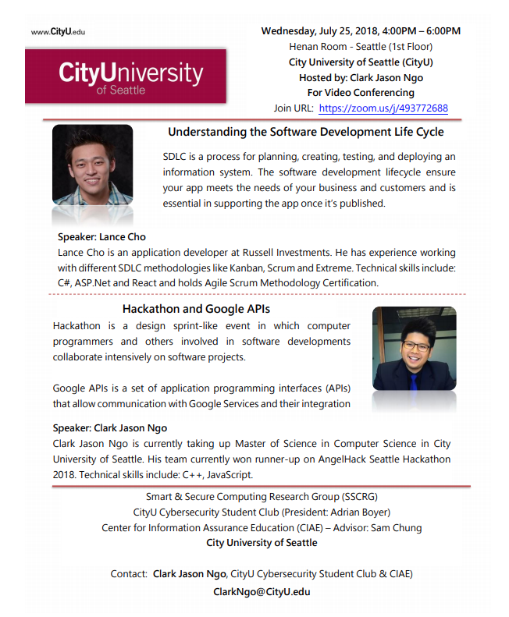
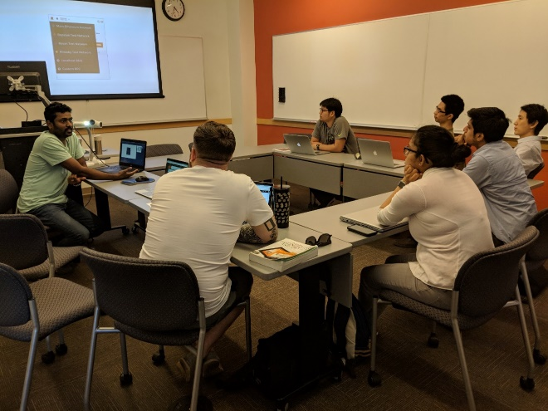
Advisory Board
Network & Security Lab (TI-Driven)
Smart & Secure Computing Research Group
(TI Faculty-Driven)
Cybersecurity Club (Student-Driven)
Center for Information Assurance Education (CIAE)
(NSA/DHS CAE-CDE)
Secure Coding Club (Student-Driven)

Slide 3

Why Python?
Monolingual
Bilingual
Multilingual

Slide 4
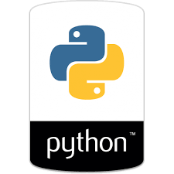
Why Python?
The first-choice language of a vast majority of students and skilled programmers.
“Python ‘produces’ fewer lines of code than many other languages, but is still readable and modifiable”
A multipurpose language used for various tasks
Web development
Data science
Networking
Machine learning
….

Slide 5

Speaking Language
Tool – Word Processor
Living well in the USA
If you speak English very well in the USA, can you be very successful?
Language - English
Culture – Vocabularies, Idioms

Slide 6
Cyber-Physical System (CPS)
Tool – Word Processor
IDE
Learning Languages in Physical Space
Learning Languages in Cyber Space
Natural Language - English
Culture – Vocabularies, Idioms
Programming Language - Python
Culture – Libraries, Framework

Slide 7
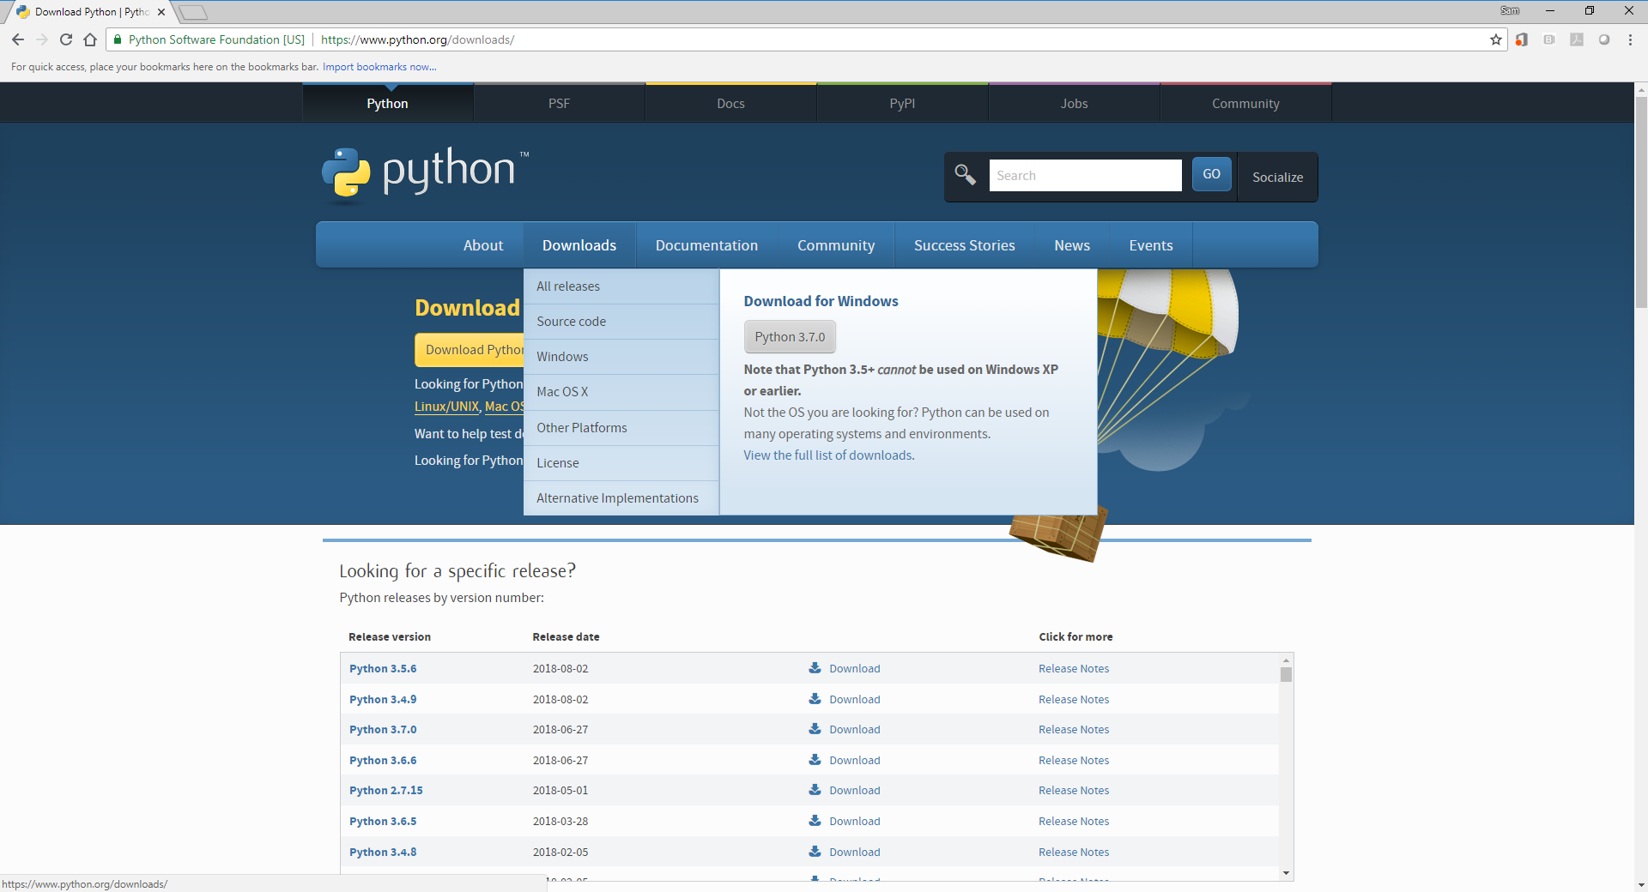
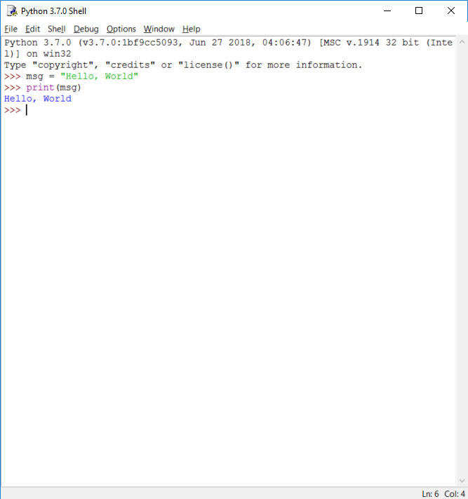
Python & IDLE
Python’s Integrated Development and Learning Environment
https://www.python.org/

Slide 8

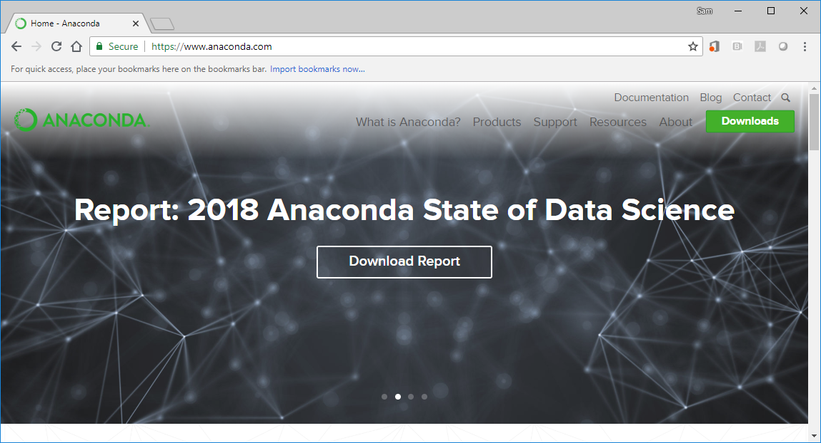
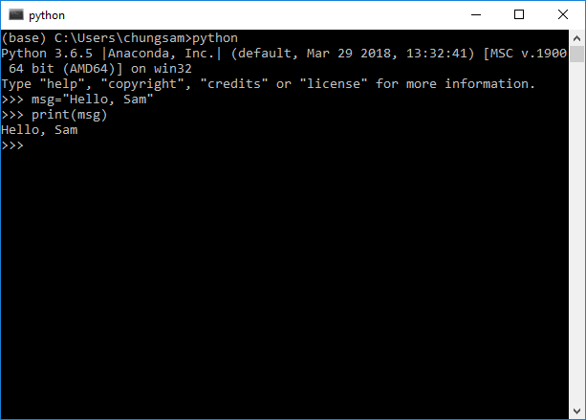
Anaconda
The Most Popular Python Data Science Platform
https://www.anaconda.com/

Slide 9
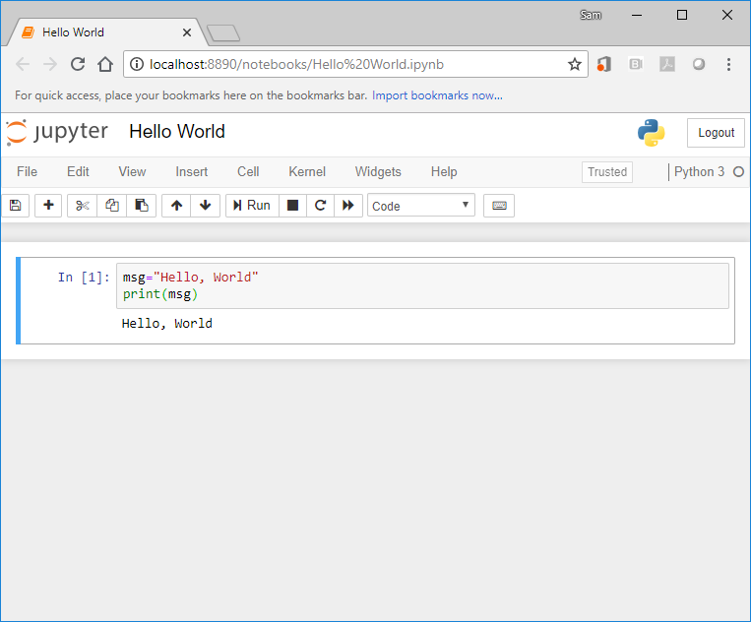
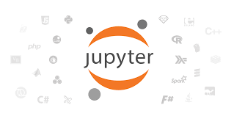
Jupyter Notebook
An open-source web application that allows you to create and share documents that contain live code, equations, visualizations and narrative text.
Uses include: data cleaning and transformation, numerical simulation, statistical modeling, data visualization, machine learning, and much more.
http://jupyter.org/

Slide 10

Microsoft Visual Studio Code
Visual Studio Code is a lightweight but powerful source code editor which runs on your desktop and is available for Windows, macOS and Linux.
It comes with built-in support for JavaScript, TypeScript and Node.js and has a rich ecosystem of extensions for other languages (such as C++, C#, Java, Python, PHP, Go) and runtimes (such as .NET and Unity)
https://code.visualstudio.com/

Slide 11
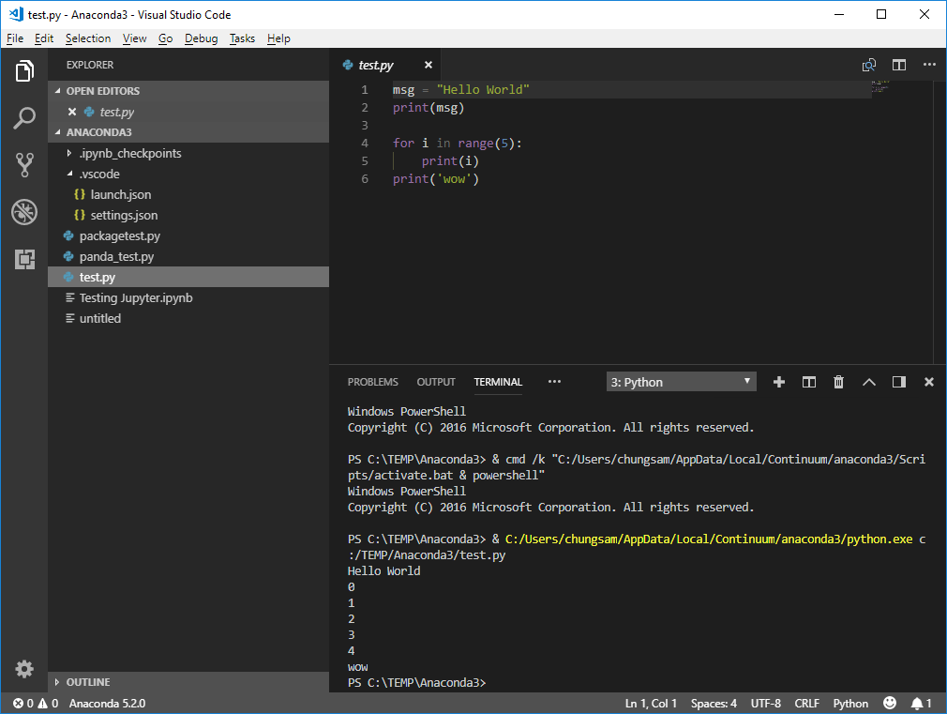

Slide 12
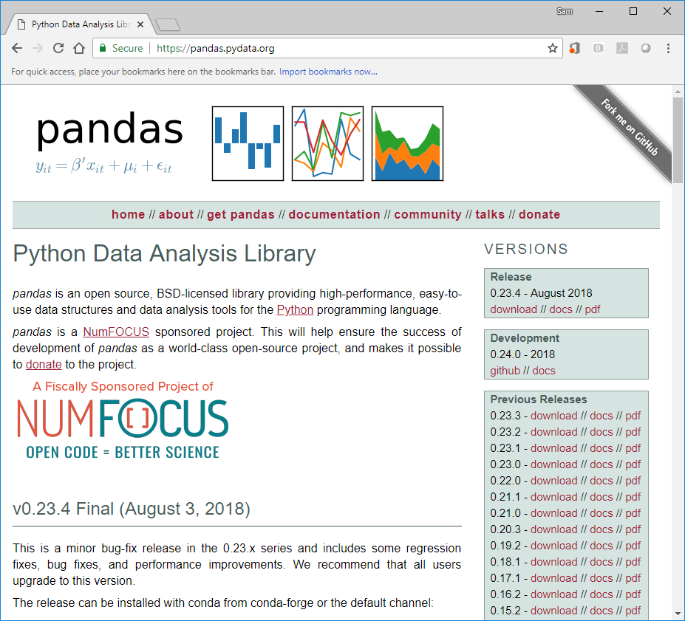

Pandas
Python Data Analysis Library
https://pandas.pydata.org/

Slide 13
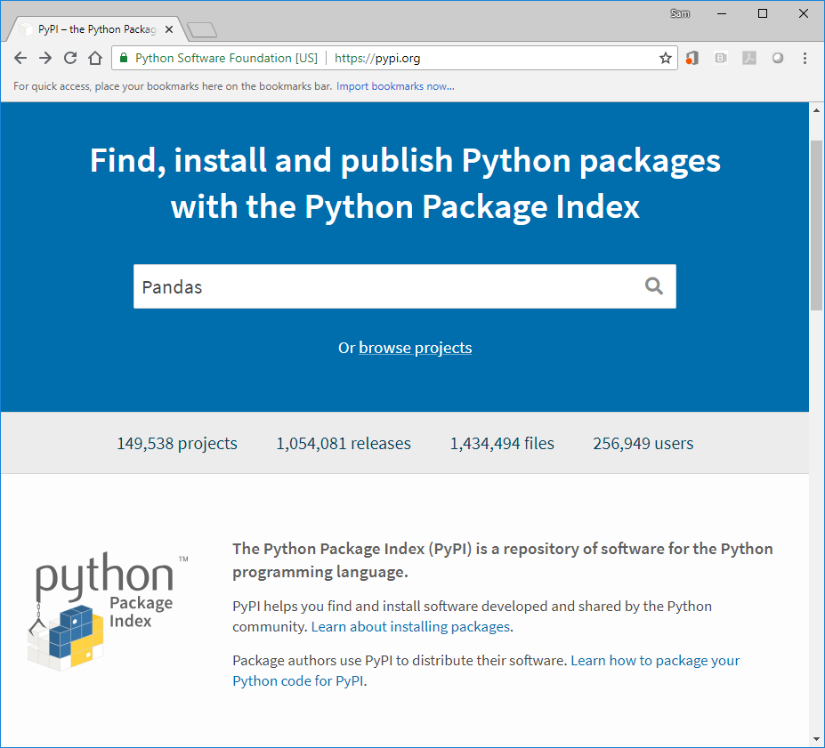
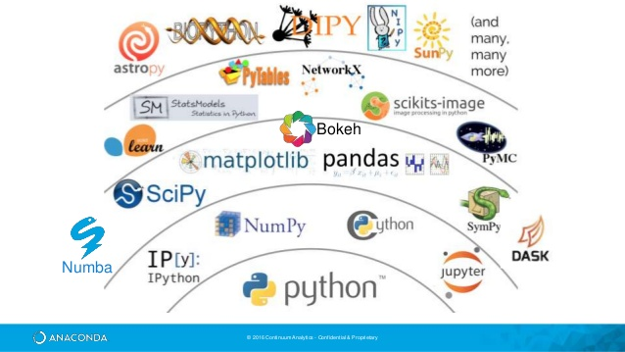
Python Package Index (PyPI)
https://www.python.org/

Slide 14
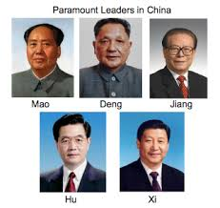
Cyber-Physical System (CPS)
IDE
Learning Languages in Cyber Space
Programming Language - Python
Culture – Libraries, Framework
Openness

Slide 15


Two Talks - Community & Industry
Dr. Garyson Williams Software engineer at Mercedes Benz Research and Development North America (MBRDNA)
Dr. Sarah Stone Executive Director at eScience Institute
https://escience.washington.edu/

